Slide 1
Cafeteria Menu Display
SlideMake.com

Slide 2
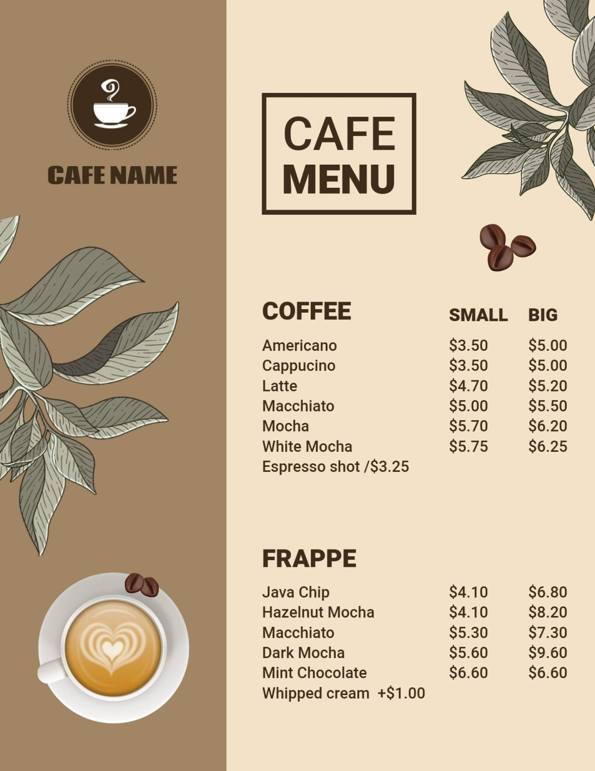
Introduction to Cafeteria Menu Display
A well-designed menu display enhances the dining experience for customers.
It provides clear information about available food options and prices.
An effective display can also promote healthier choices and special offers.
Notes:
Image source: https://i.pinimg.com

Slide 3
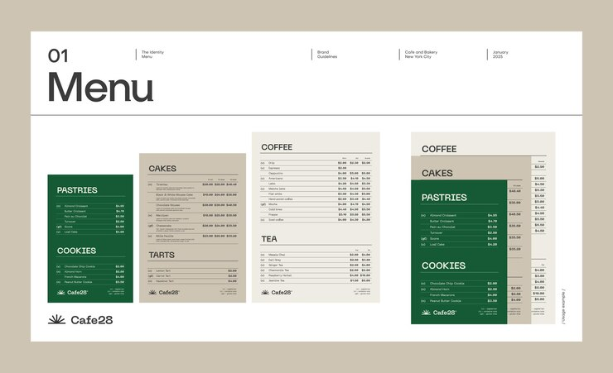
Importance of Visual Appeal
Visual elements attract customers and encourage them to try new dishes.
Use of bright colors and appealing images can make the menu more inviting.
Consistent branding helps reinforce the cafeteria’s identity.
Notes:
Image source: https://img.freepik.com

Slide 4
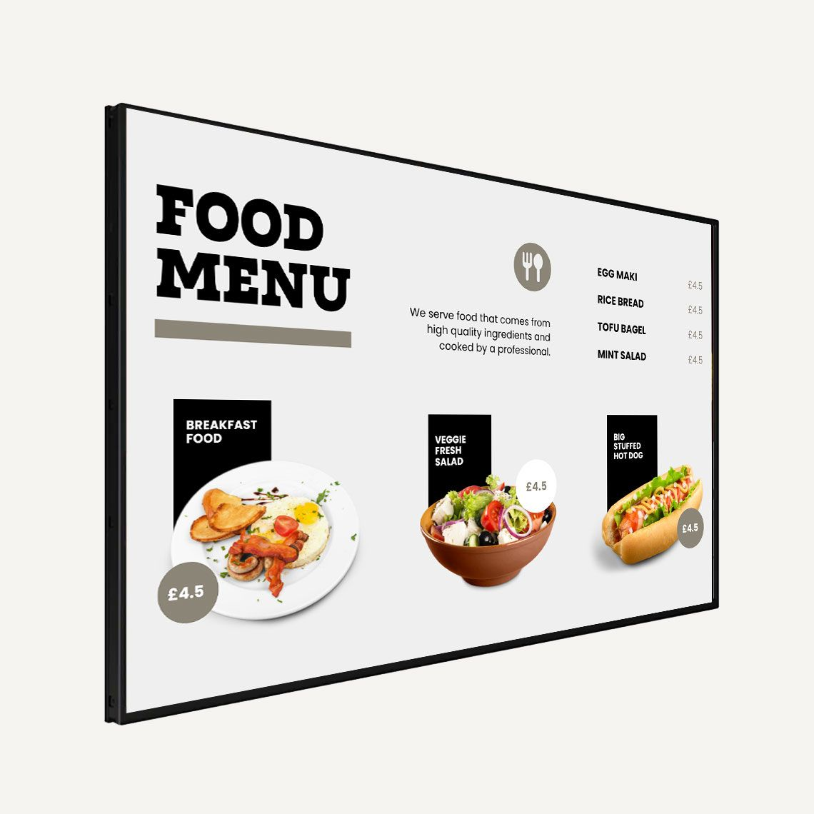
Types of Menu Display Formats
Digital screens offer dynamic updates and vibrant visuals.
Traditional printed menus provide a tangible and easy-to-read option.
Interactive kiosks can engage customers and streamline ordering processes.
Notes:
Image source: https://i.pinimg.com

Slide 5
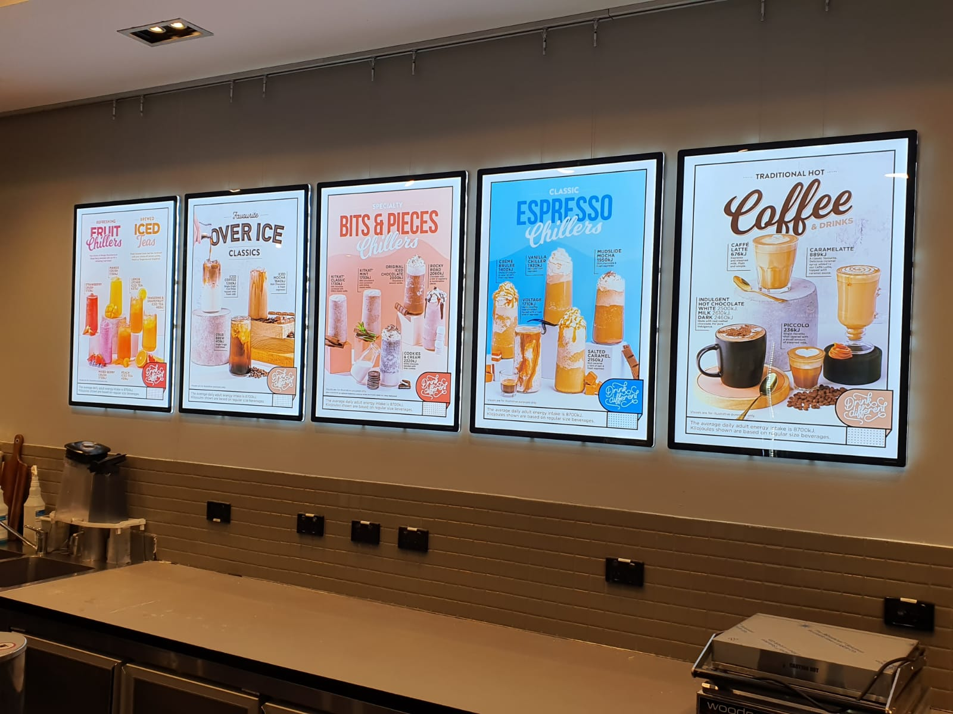
Designing an Effective Menu Layout
Organize menu items logically, such as by meal type or dietary considerations.
Use clear headings and readable fonts to enhance readability.
Highlight specials and popular items to draw attention.
Notes:
Image source: https://www.vitrinemedia.com.au

Slide 6
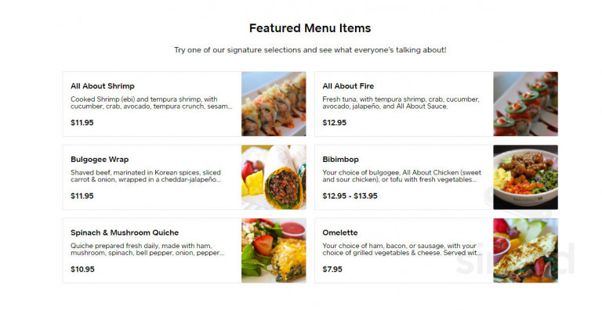
Choosing the Right Content
Include essential details like dish names, descriptions, and prices.
Use appealing images to showcase key dishes and entice customers.
Ensure all information is accurate and up-to-date to maintain trust.
Notes:
Image source: https://www.upmenu.com

Slide 7
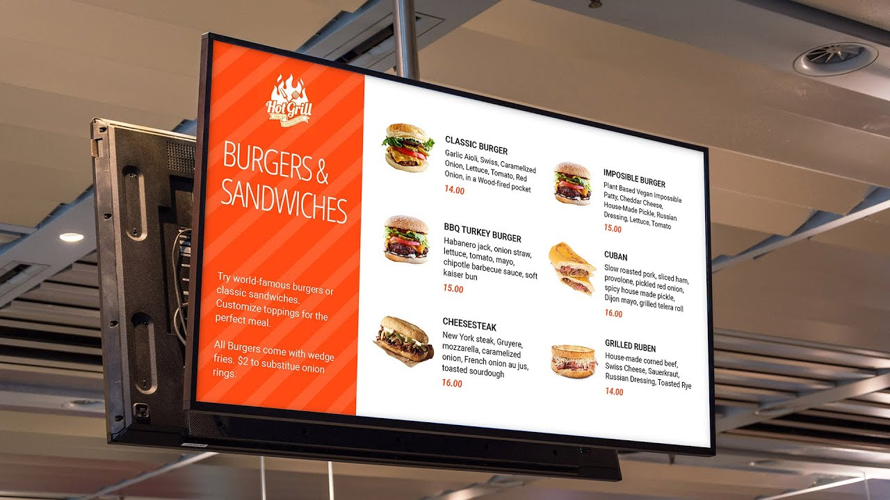
Incorporating Accessibility Features
Use large fonts and high-contrast colors for easy reading by all customers.
Include braille or tactile elements for visually impaired individuals.
Arrange menu items to minimize clutter and facilitate quick scanning.
Notes:
Image source: https://i.ytimg.com

Slide 8
Technology Integration in Menu Displays
Digital displays can be programmed for real-time updates and promotions.
QR codes allow customers to access detailed menus on their smartphones.
Integrating ordering systems can reduce wait times and improve efficiency.
Notes:
Image source: https://www.vitrinemedia.com.au

Slide 9
Maintaining and Updating Menu Displays
Regularly review menu content to reflect seasonal changes and new offerings.
Keep digital screens clean and functioning properly for a professional appearance.
Solicit feedback from customers to identify areas for improvement.
Notes:
Image source: https://www.vitrinemedia.com.au

Slide 10
Best Practices and Tips
Keep the menu simple and avoid overcrowding information.
Use high-quality images and consistent fonts for a professional look.
Train staff to assist customers in navigating the menu display effectively.
Notes:
Image source: https://www.vitrinemedia.com.au

Slide 11
Conclusion and Future Trends
Effective menu displays can significantly enhance customer satisfaction.
Emerging trends include the use of augmented reality and personalized menus.
Continual innovation and feedback are key to maintaining an engaging cafeteria experience.
Notes:
Image source: https://www.vitrinemedia.com.au

